Slide 1
FBG20N18BSH Reliability Data
5/1/24

Slide 2
FBG20N18BSH Switching Life Test
Tested variations of VDS voltage, IDS current and Switching Frequency in a high side buck converter over a 2000 hours time and across 3 wafer lots.
VDS tested : 140V and 170V (Nominal) measured at Power supply and does not include any overshoot occurring at the DUT due to the buck circuit performance.
Iout tested : 1A, 4A
Parts tested with full parametric test at interim steps 48,hrs, 120hrs, 260hrs, 500hrs, 1000hrs, 2000hrs
No failures have been observed thru 2000hrs

Slide 3
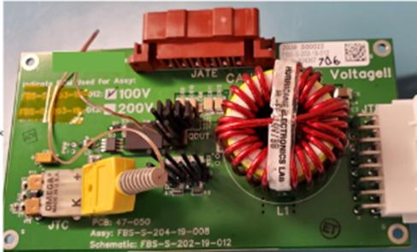
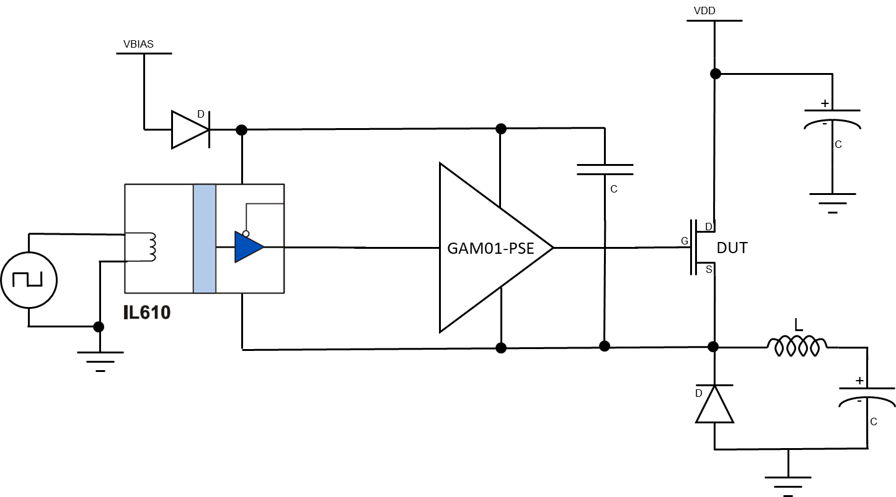
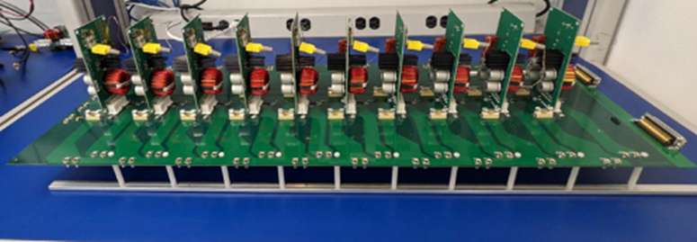
FBG20N30BSH Circuit
The circuit was not optimized for efficiency but rather to demonstrate the stability of device and Rdson.
GAM01 Driver
FBG20N18
FBG20N18
Or
FBG10N30
Simplified High Side Buck converter circuit

Slide 4
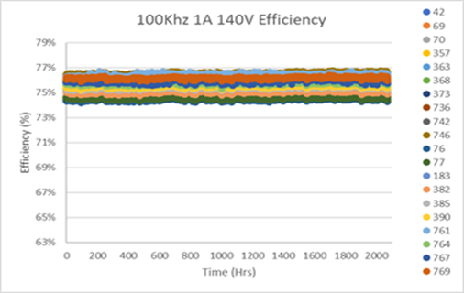
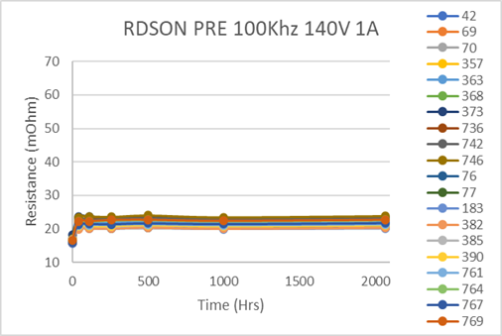
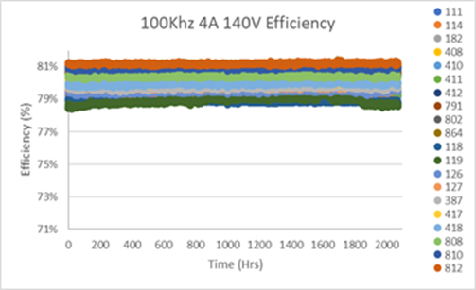
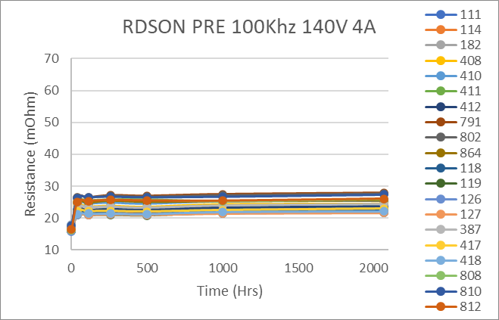
EFFICIENCY at 100kHz VDS=140V-170V Io=1A - 4A

Slide 5
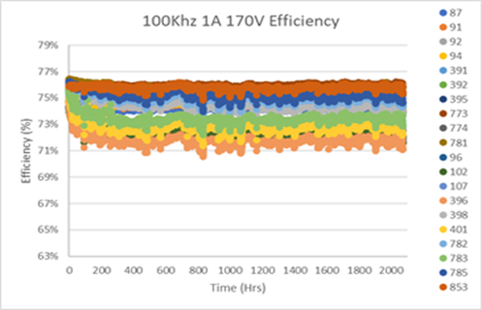
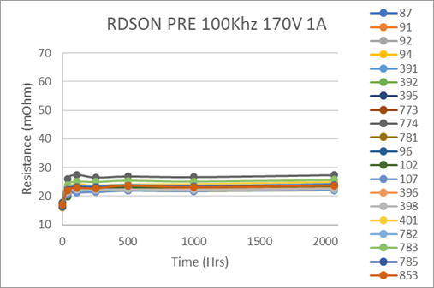
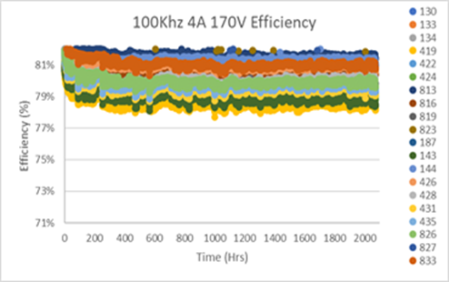
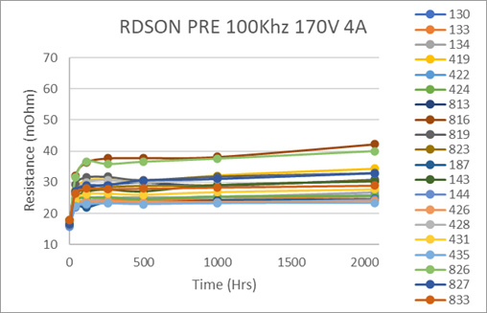
EFFICIENCY at 100kHz VDS=140V-170V Io=1A - 4A

Slide 6
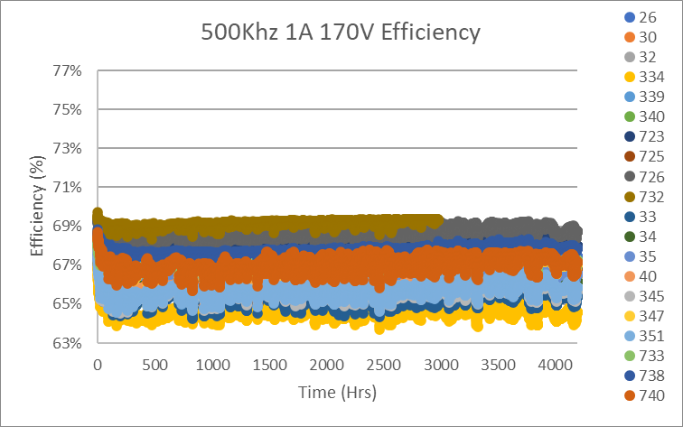
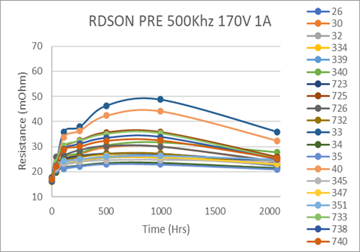
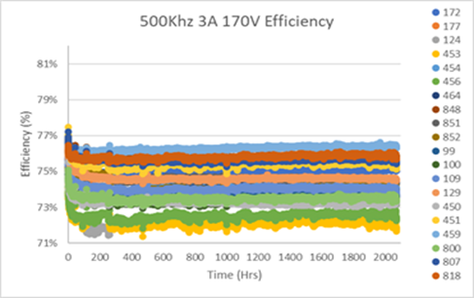
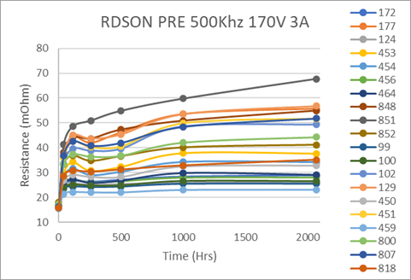
EFFICIENCY at 500kHz VDS=140V-170V Io=1A - 3A
Temp = ~60C

Slide 7
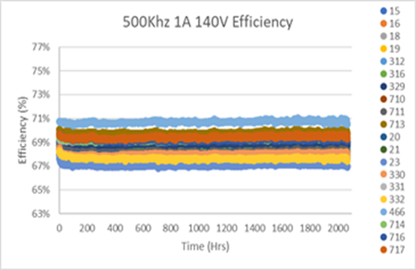
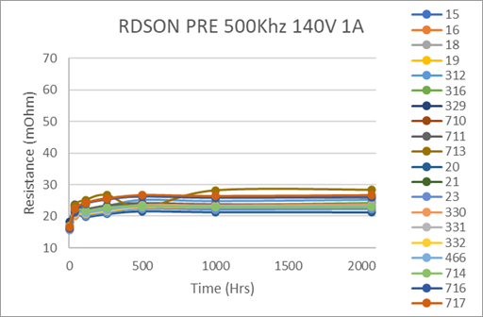
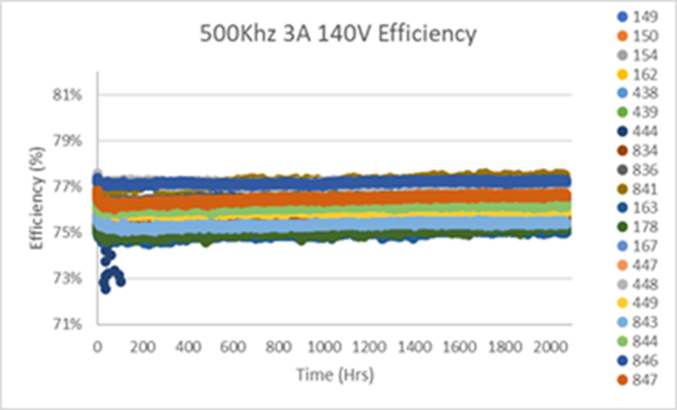
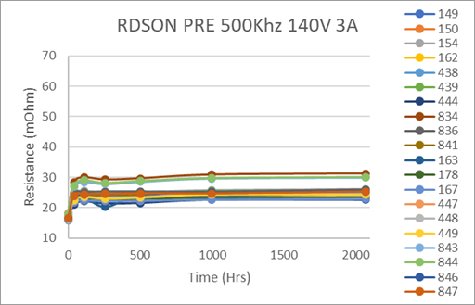
EFFICIENCY at 500kHz VDS=140V-170V Io=1A - 3A

Slide 8
FBG20N18 DC LIFE
Tested variations of VDS and VGS voltages over several temperatures over a 2000Hrs timeframe
VDS Tested : 200V, 230V, 250V at Temperatures of 100C and 130C
VGS Tested : 6V, 6.75V, 7.25V at Temperatures of 100C and 150C
Parts tested with full parametric test on Focused tester at interim steps 24hrs, 48,hrs, 96hrs, 210hrs, 500hrs, 1000hrs, 1500hrs, 2000hrs
Parts with very high leakage were removed at each step
X axis (voltage represents Applied stress voltage not test voltage)

Slide 9
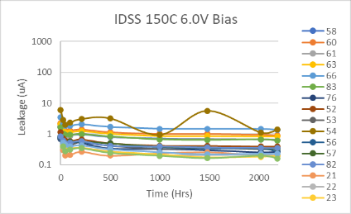
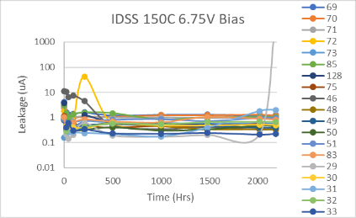
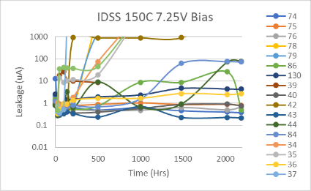
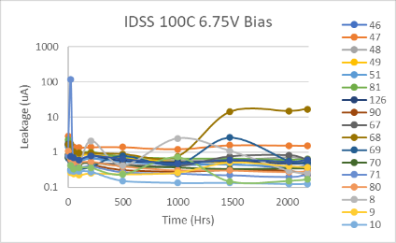
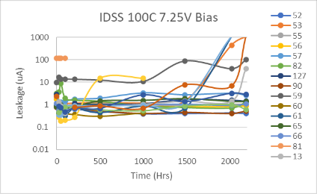
FBG20N18 HTGB LIFE
IDSS tested at 200V
9

Slide 10
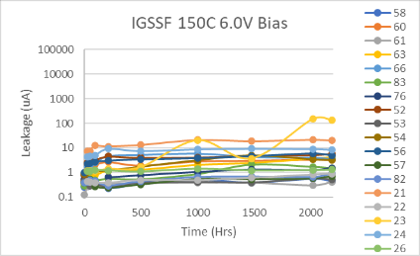
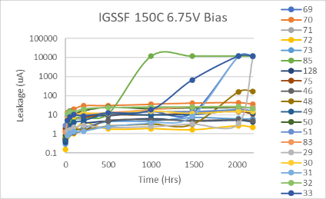
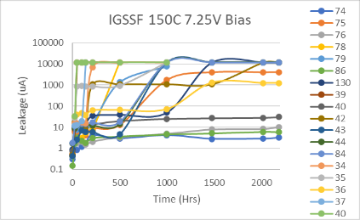
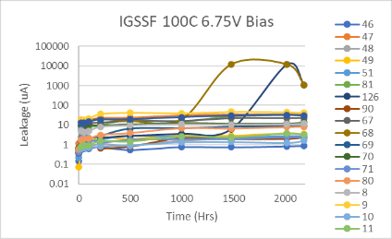
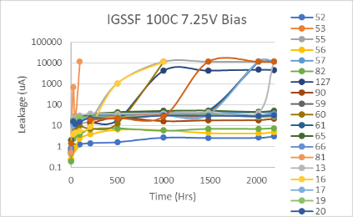
FBG20N18 HTGB LIFE
IGSSF tested at 5V
10

Slide 11
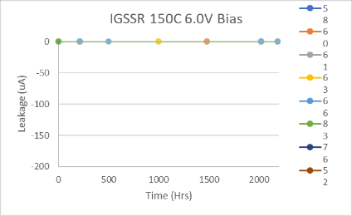
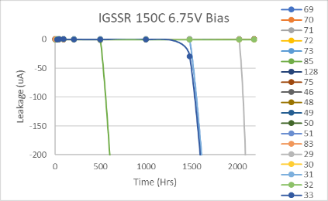
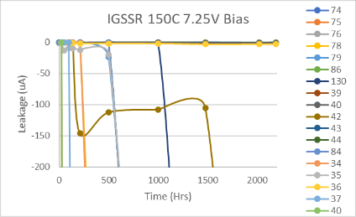
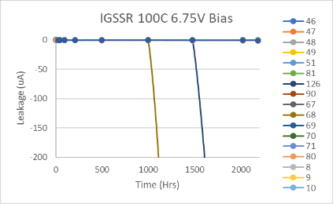
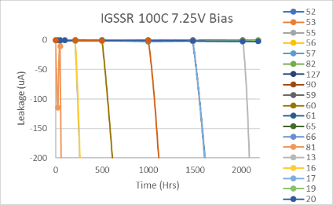
FBG20N18 HTGB LIFE
IGSSR tested at -4V
11

Slide 12
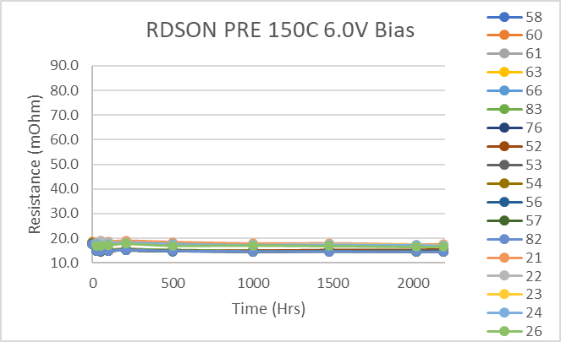
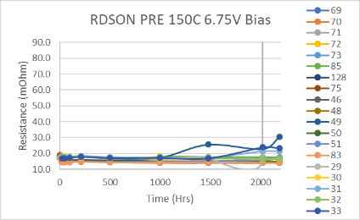
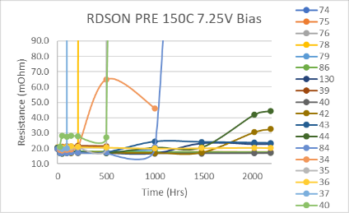
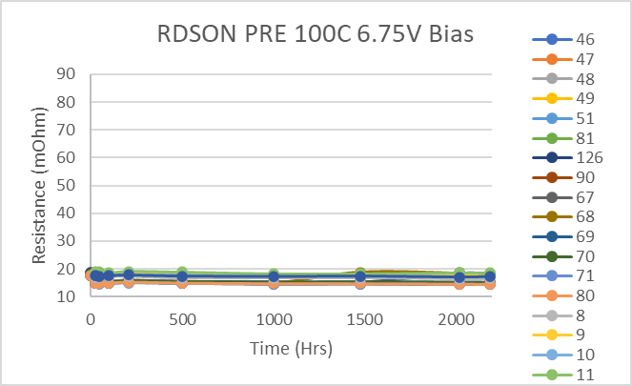
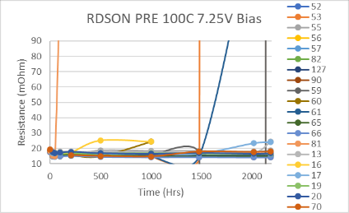
FBG20N18 HTGB LIFE
RDSON at 18A VGS@5V
12

Slide 13
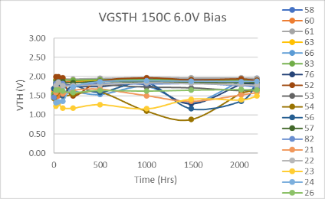
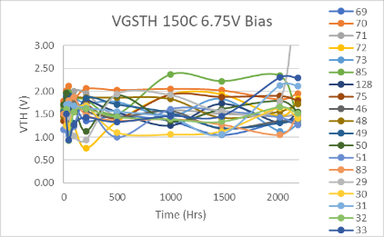
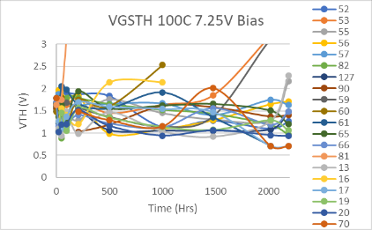
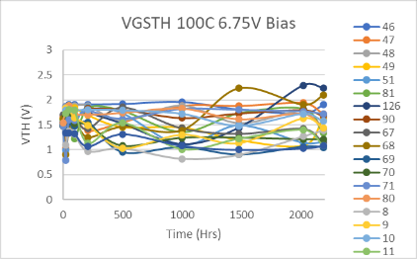
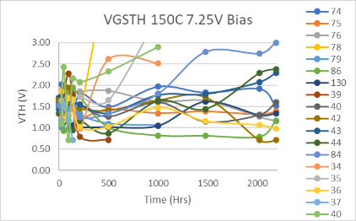
FBG20N18 HTGB LIFE
Vgsth at 3mA
13

